Slide 1
WE ARE LEARNING TO:
Recognise and celebrate the impact kindness can have on another person.

Slide 2
Winston Churchill

Slide 3
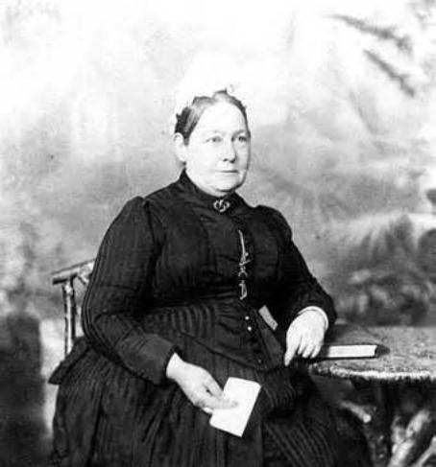
Elizabeth Everest
Can you design an award to honour Elizabeth for the way she looked after Winston?

Slide 4
God is fair; he will not forget the work you did and the love you showed for him by helping his people. And he will remember that you are still helping them. Hebrews 6:10

