Slide 1
PGL 2019 Parent Information Evening

Slide 3
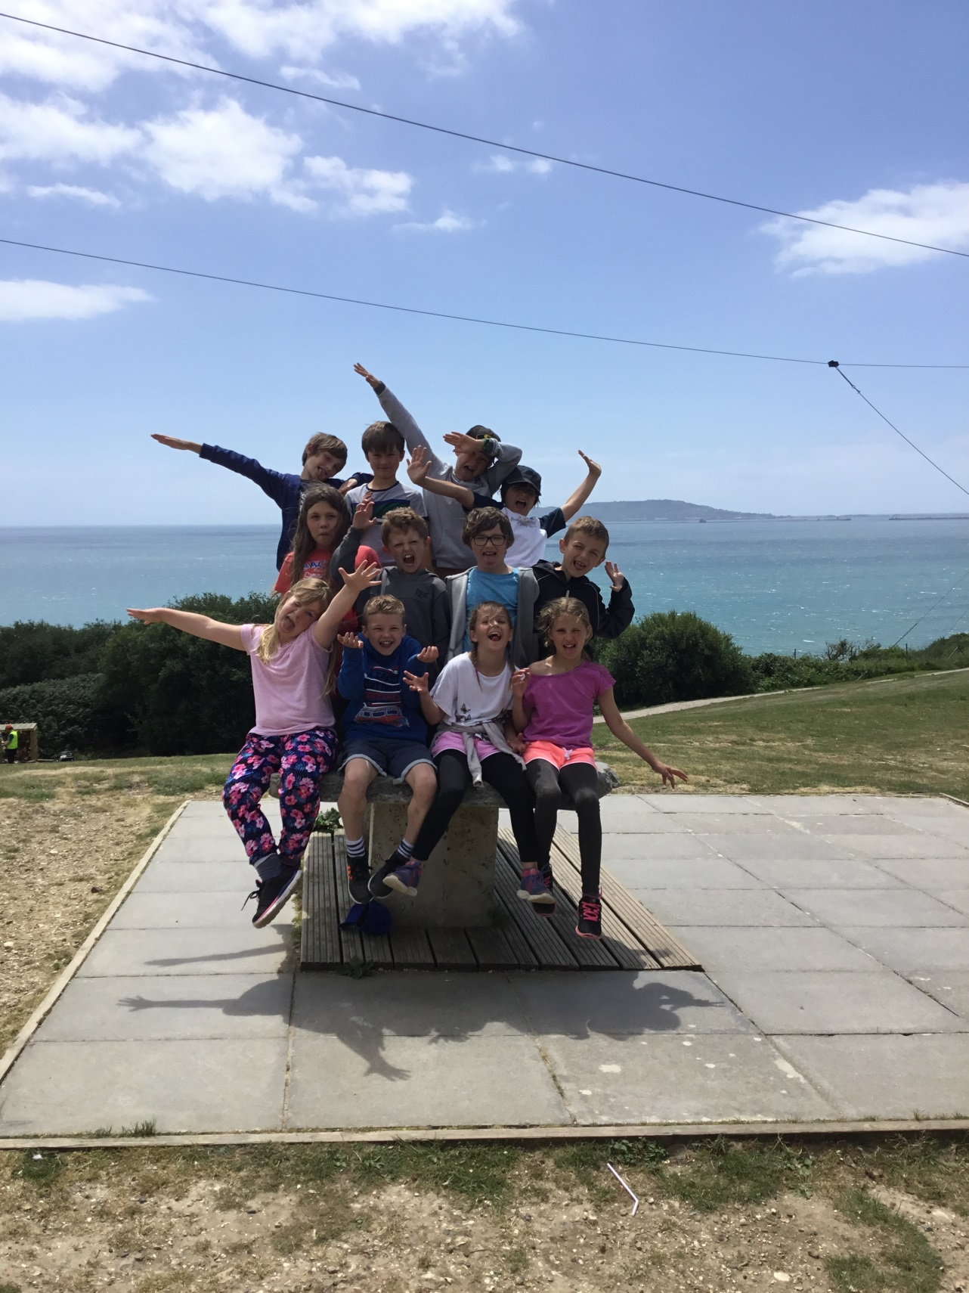

Slide 4
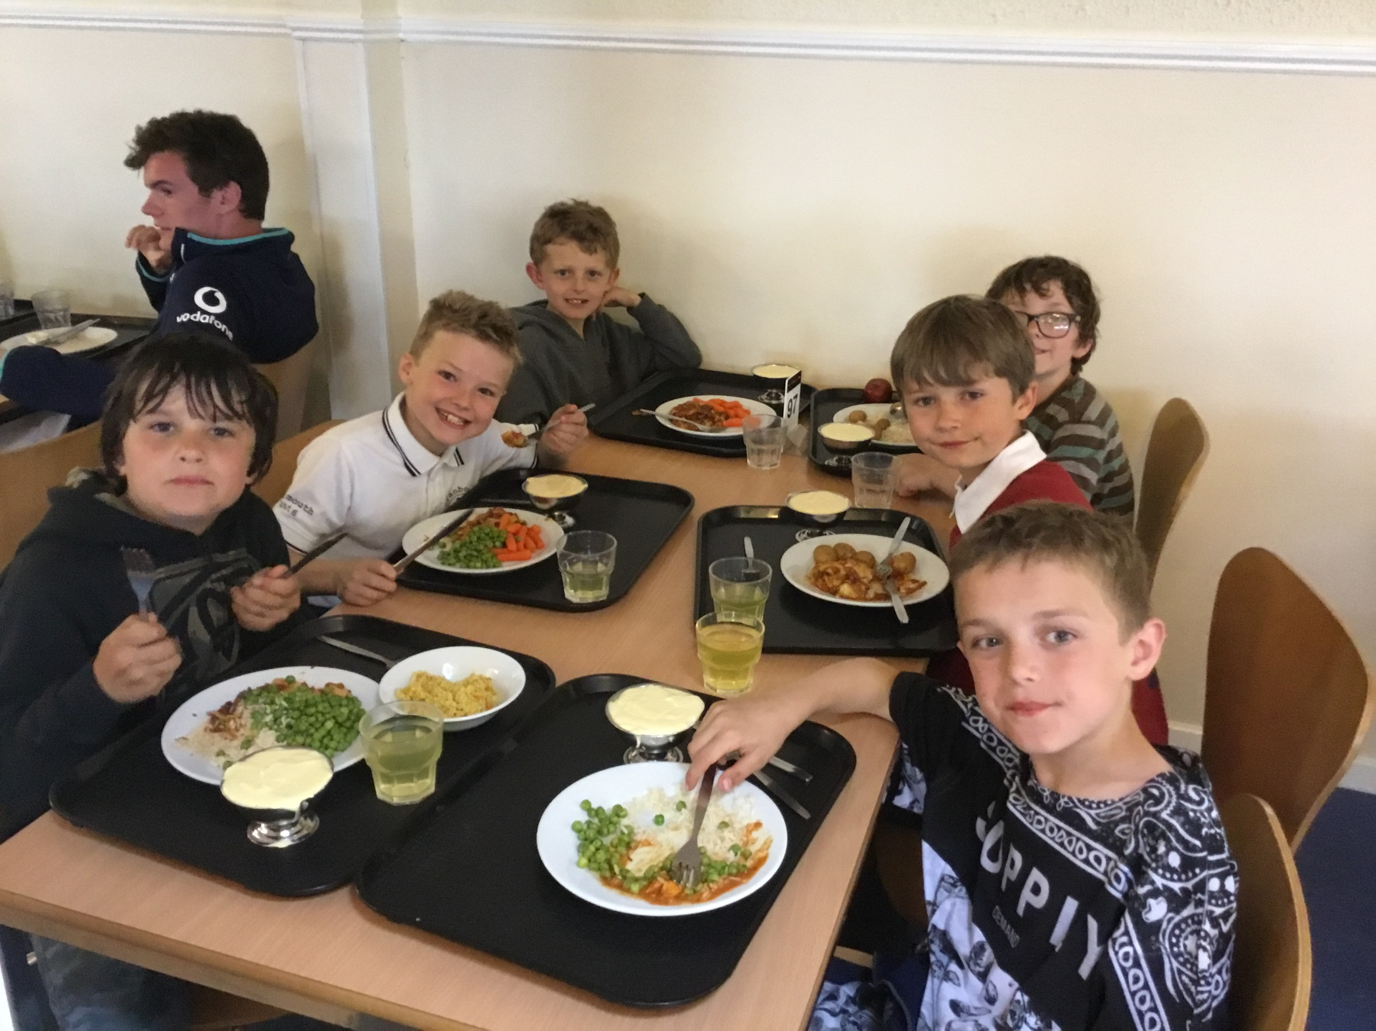

Slide 7
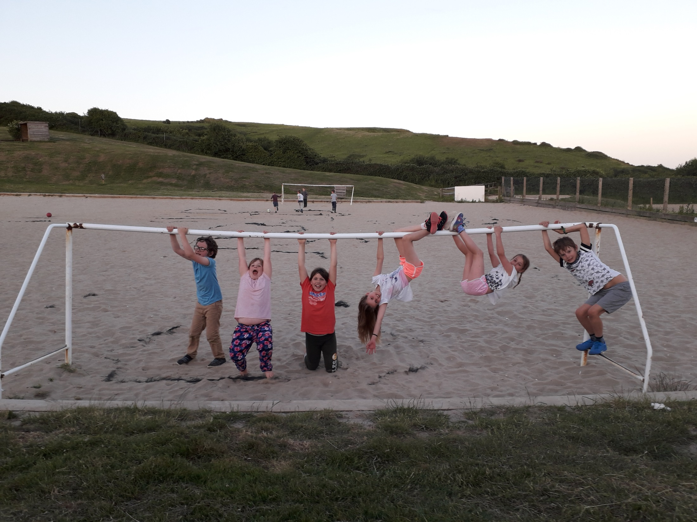

Slide 8
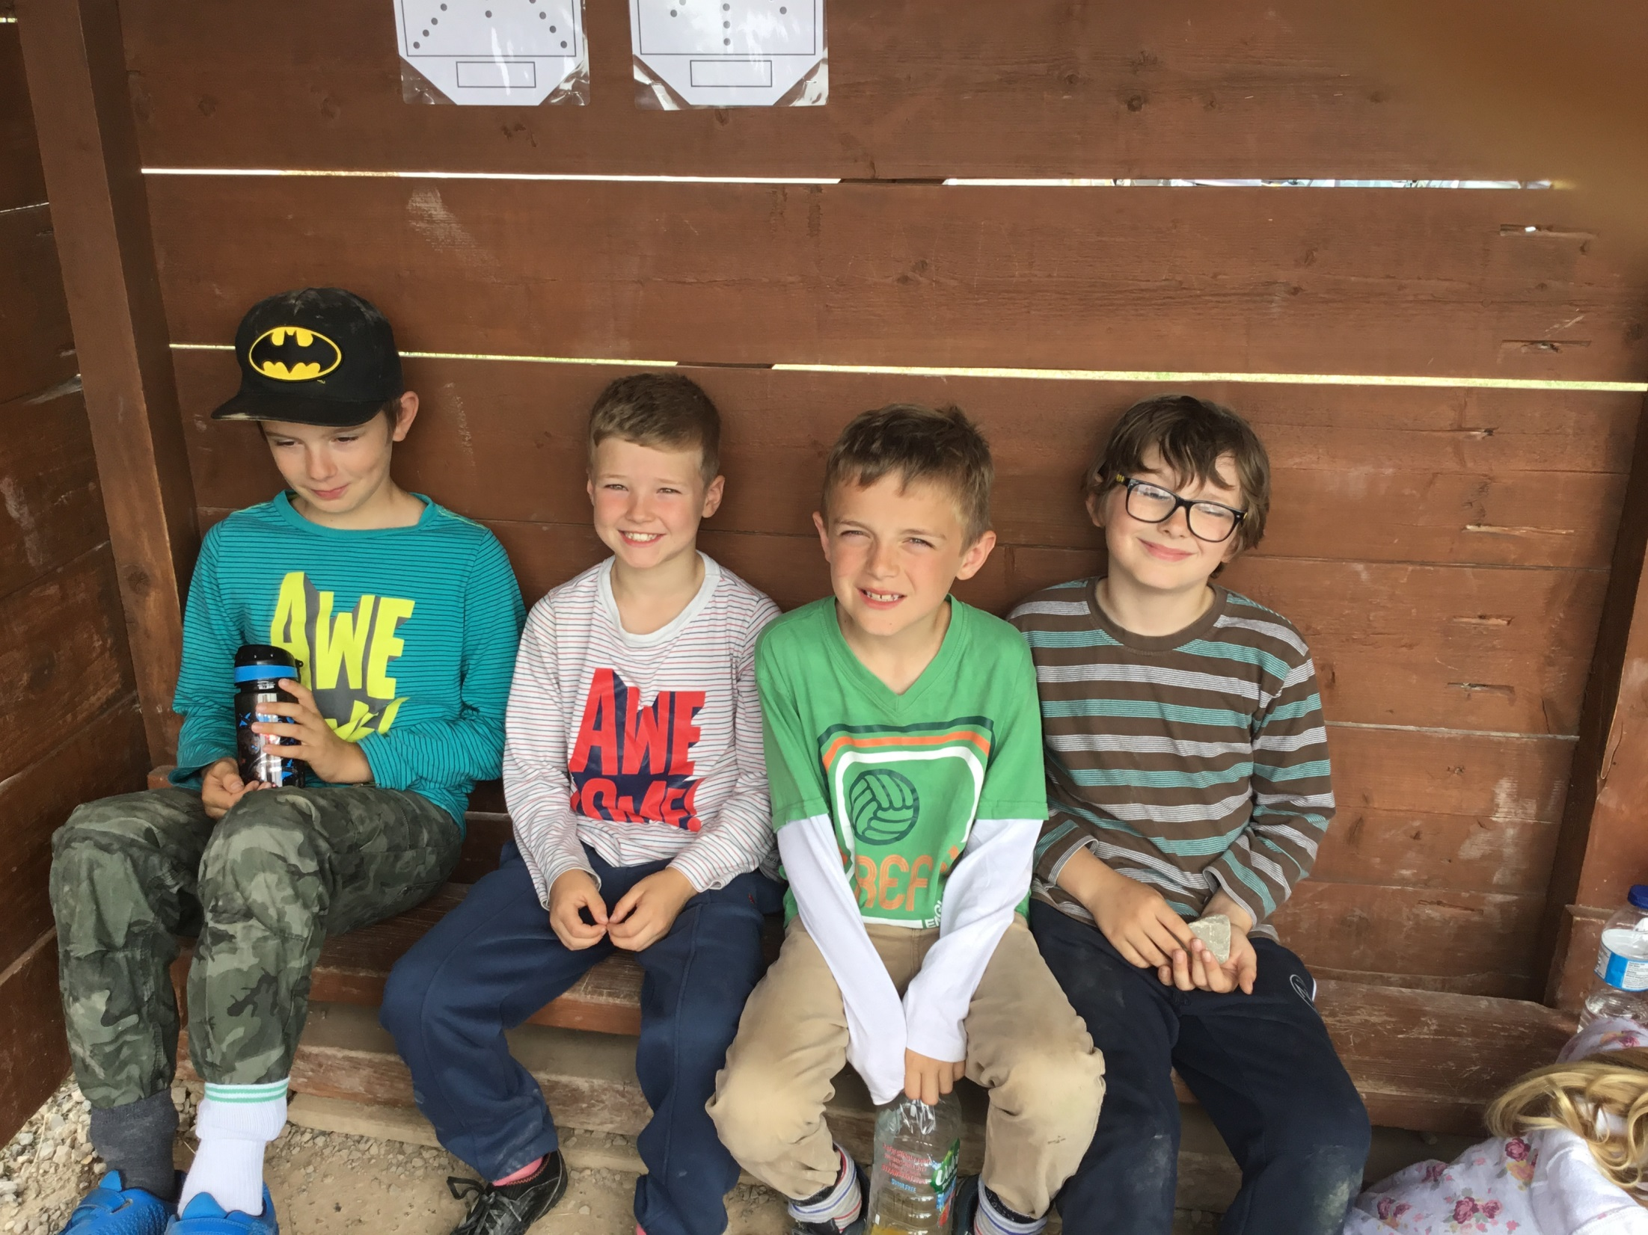

Slide 11
Payment Schedule 1
Payment | Due
£30.00 Deposit | 1.10.18
£30.00 | 1.11.18
£30.00 | 1.2.19
£30.00 | 1.3.19
£30.00 | 1.4.19
£25.00 Final balance due | 1.05.18

Slide 12
Payment Schedule 2
Payment | Due
£30.00 Deposit | 1.10.18
£145.00 | 1.05.18

Slide 13
TIME FOR QUESTIONS….

