Slide 1
Words ending with the /f/, /l/, /s/, /z/ or /k/ sound in English almost always have double consonant.
Introduction | Words ending with the /f/, /l/, /s/, /z/ or /k/ sound in English almost always have double consonant. This week’s words are shown in random order. Sound the words out and count the sounds. Ask the children if they can see a pattern with the last sound. Discuss that the /k/ sound is usually written as “ck”.
Main Teaching Activity | Read the sentence for each word and ask children for the word and spelling to reinforce the double-consonant rule.
Independent Activity | Ask the children to choose one of their words to complete the two sentences. Then ask them to choose three more words and write their own sentences. Work in pairs or with support if necessary. Share sentences and spellings with the class.
Spellings
puff
fluff
bell
doll
grass
kiss
buzz
fizz
clock
back

Slide 2
Words ending with the /f/, /l/, /s/, /z/ or /k/ sound in English almost always have double consonant.
puff
doll
back
clock
grass
kiss
fluff
bell
buzz
fizz

Slide 3
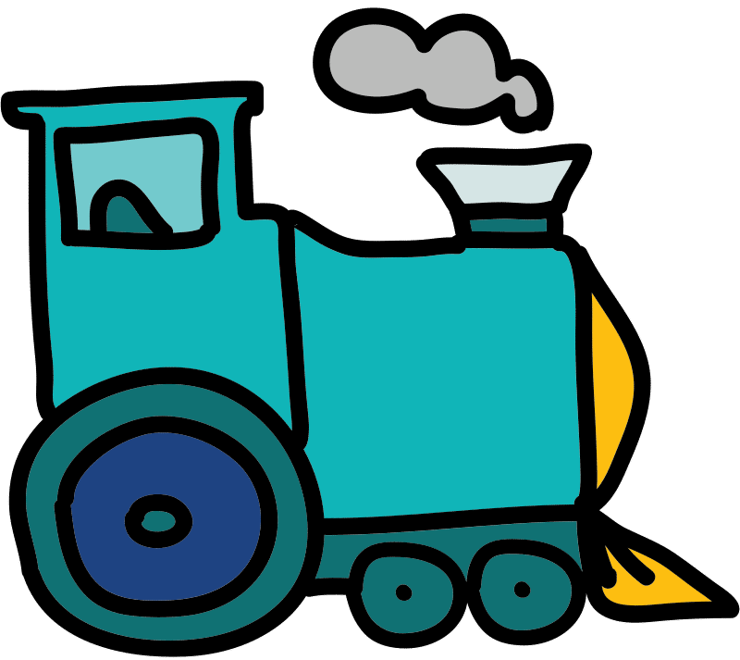
A _______ of smoke came from the train.

Slide 4
A _puff_ of smoke came from the train.
Answer:

Slide 5
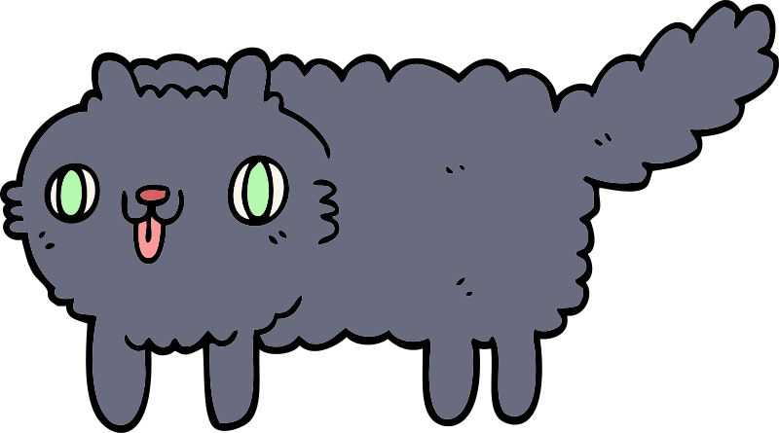
The kitten was covered in _______.

Slide 6
The kitten was covered in _fluff_.
Answer:

Slide 7
The teacher rang the _______.

Slide 8
Answer:
The teacher rang the _bell_.

Slide 9
The _______ has a blue dress.

Slide 10
The _doll_ has a blue dress.
Answer:

Slide 11
The _______ on the field is green.

Slide 12
The _grass_ on the field is green.
Answer:

Slide 13
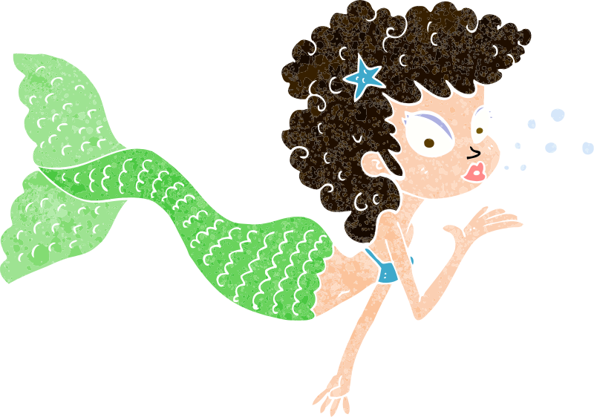
The mermaid blew a _______.

Slide 14
Answer:
The mermaid blew a _kiss_.

Slide 15
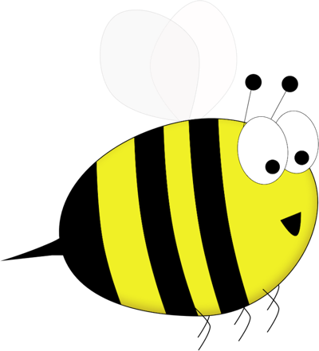
Bumble’s wings _______.

Slide 16
Bumble’s wings _buzz_.
Answer:

Slide 17
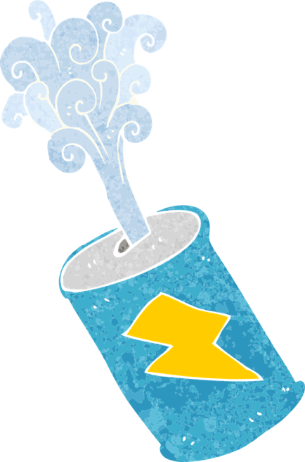
The can was full of _______.

Slide 18
Answer:
The can was full of _fizz_.

Slide 19
You tell the time by using a _______.

Slide 20
You tell the time by using a _clock_.
Answer:

Slide 21
The girl’s hair ran down her _______.

Slide 22
The girl’s hair ran down her _back_.
Answer:

Slide 23
Words ending with the /f/, /l/, /s/, /z/ or /k/ sound in English almost always have double consonant.
Chose one of your words to complete the two sentences. Try to write three sentences of your own.
Spellings
puff
fluff
bell
doll
grass
kiss
buzz
fizz
clock
back
Your word
Your sentence
The clouds looked like balls of _________ in the sky.
“Can you hear the church _________?” asked mum.

Slide 24
Words ending with the /f/, /l/, /s/, /z/ or /k/ sound in English almost always have double consonant.
Spellings | 1st Attempt | 2nd Attempt | 3rd Attempt | 4th Attempt | 5th Attempt
puff
fluff
bell
doll
grass
kiss
buzz
fizz
clock
back

Slide 25
Words ending with the /f/, /l/, /s/, /z/ or /k/ sound in English almost always have double consonant.
Spellings
puff
fluff
bell
doll
grass
kiss
buzz
fizz
clock
back
p | u | f | f | q | d | b | e | l | l
a | v | r | f | l | u | f | f | o | p
j | d | o | l | l | n | b | l | k | g
w | v | e | i | s | p | q | j | n | r
f | b | u | z | z | a | c | h | i | a
c | l | o | c | k | g | r | n | o | s
v | g | a | h | y | s | k | i | s | s
a | b | a | c | k | f | b | c | f | m
k | x | l | z | c | f | i | z | z | z
Find and colour your spellings which are hiding in this grid.

Slide 26
Words ending with the /f/, /l/, /s/, /z/ or /k/ sound in English almost always have double consonant.
Spellings
puff
fluff
bell
doll
grass
kiss
buzz
fizz
clock
back
p | u | f | f | q | d | b | e | l | l
a | v | r | f | l | u | f | f | o | p
j | d | o | l | l | n | b | l | k | g
w | v | e | i | s | p | q | j | n | r
f | b | u | z | z | a | c | h | i | a
c | l | o | c | k | g | r | n | o | s
v | g | a | h | y | s | k | i | s | s
a | b | a | c | k | f | b | c | f | m
k | x | l | z | c | f | i | z | z | z
Find and colour your spellings which are hiding in this grid.

