Slide 1
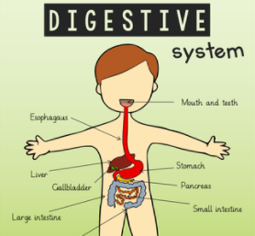
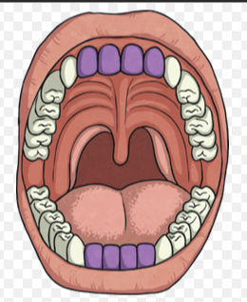
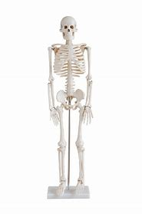
Tuesday 16th November 2021 WALT: describe parts of the digestive system.

Slide 2
What is the digestive system? - BBC Bitesize Watch this short clip about the digestive system.

Slide 10
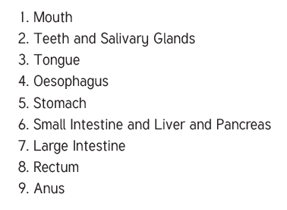

Slide 12
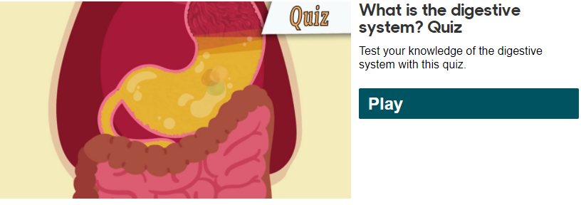
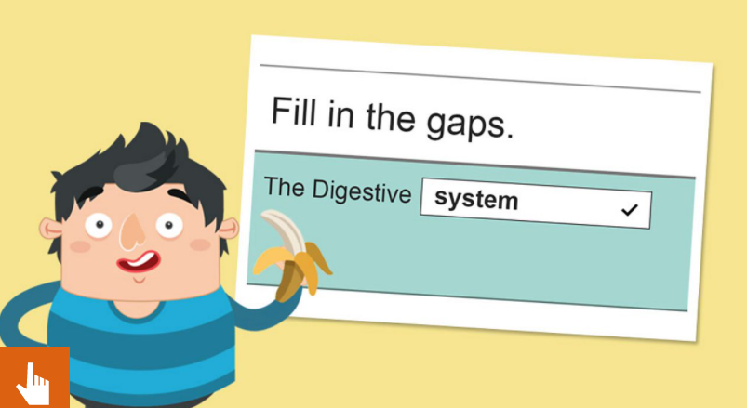
Click on the pictures to have a go at the fill the gaps activity and the quiz.

Slide 13
