Slide 1
Click through the powerpoint and then have a go at the activities on pg 6 & 7
Click on the speaker picture on the slides to hear Miss Warren.
It will look like the one below.

Slide 3
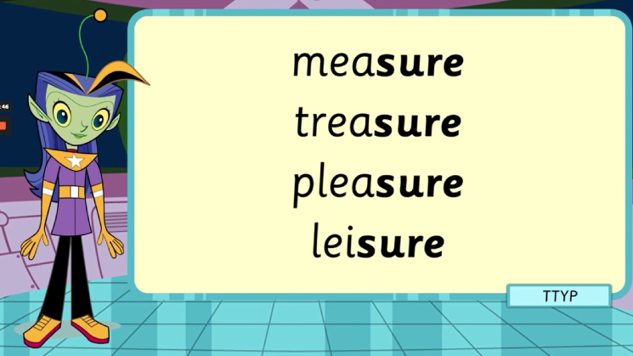

Slide 4
