Slide 1
WALT: communicate historically.
Wednesday 17th November 2021

Slide 2

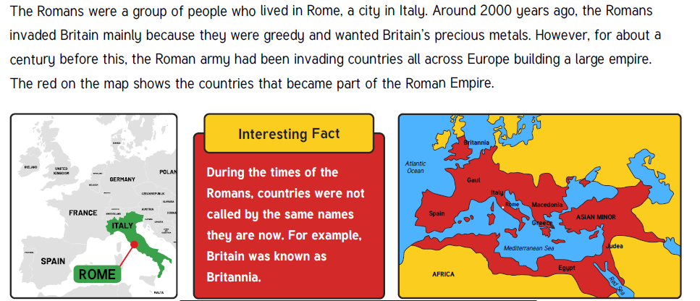

Territories – lands controlled by a ruler.

Slide 3

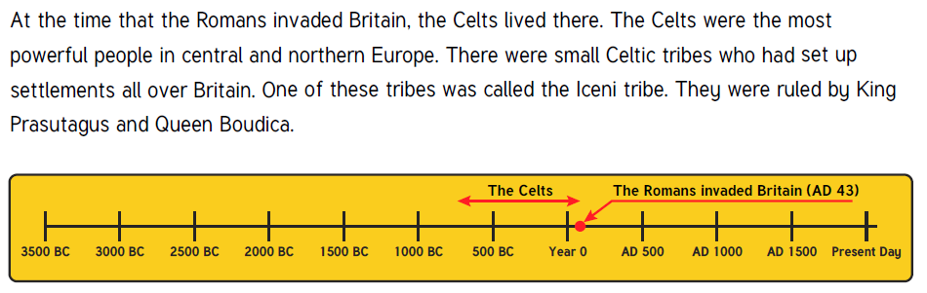
Resistance – fighting back against attacker.
The Celts put up a resistance.

Slide 4
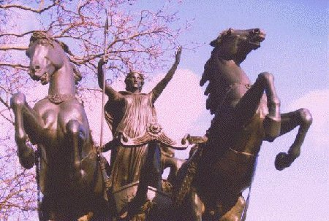
What clues does this statue by the River Thames give us to explain why Boudica was important enough to be given a statue in London.

Slide 5

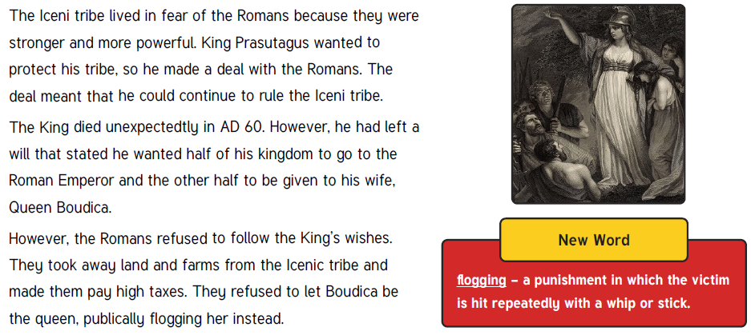
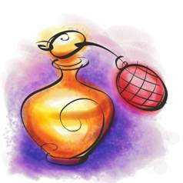
As Boudica is Queen she can afford to buy expensive luxuries like oils, wines and perfumes that now come from distant lands, thanks to the Romans.

Slide 6
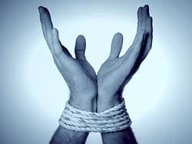

Slide 7

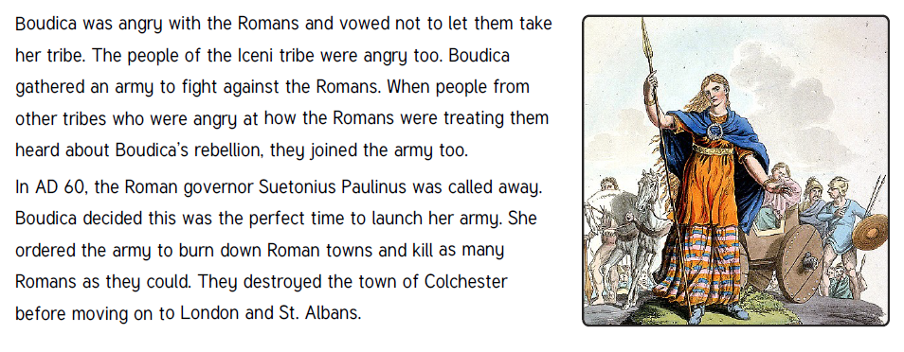

Slide 8

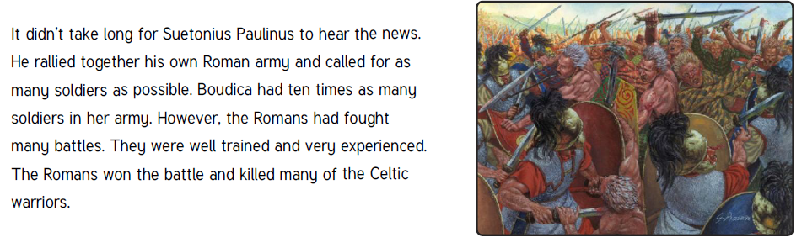

Slide 9

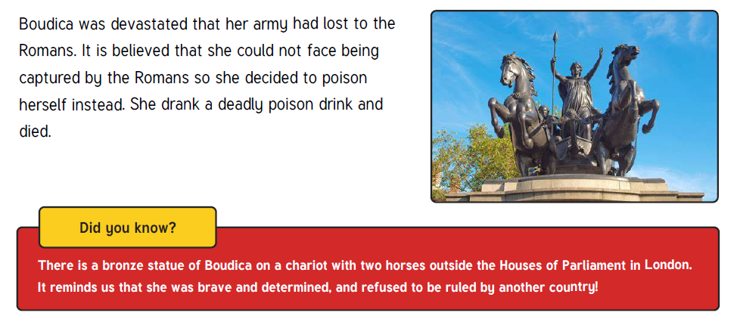

Slide 10
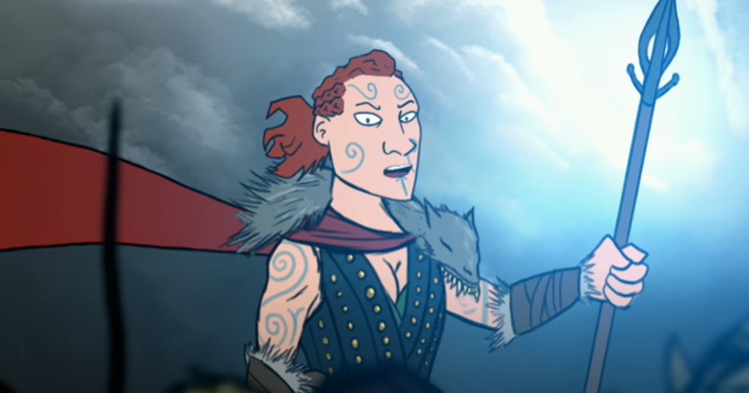
Boudicca & the Roman Invasion | The Story of Britain | BBC Teach – YouTube
The Boudica Song | Cut-Throat Celts | Horrible Histories - YouTube

Slide 11

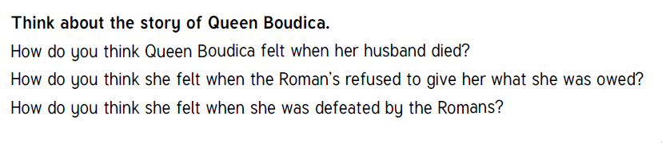

Slide 12
Version 1
So after Boudicca’s husband died, Roman officials arrived. They ignored Boudicca and began to take land from her relatives and friends to give to the Romans. They also told the people that they would have to pay higher taxes to Rome. Boudicca was very angry. She complained but the Romans refused to listen. She then decided to get her revenge.

Slide 13
Version 2
People called the Romans came from across the sea. The Iceni tribe tried to make friends with them. But the Romans stole their money and took away their farms. Boudicca loved her land and her people. She tried to stop the Romans. The Romans whipped Boudicca and her daughters. Boudicca was very angry. (She went on to burn the Roman towns as a protest)

Slide 14
Version 3
In the year AD 60, the King of the Iceni died and his wife Boudicca became queen. The Romans demanded that all loans to the old king should be repaid. When the Iceni tribe asked for extra time to pay their higher taxes and the loans, Roman soldiers marched in and demanded money and corn. They seized the lands of the queen, and when she protested, they ill-treated her and her daughters. After this outrage the Iceni rose up in an open revolt.

Slide 15
Version 4
When they heard that King Prasutagus was dead, the Romans thought that they would take all his land and treasure for themselves. They began to attack homes and farms and chased people off their land. They stole money and killed people. When Queen Boudicca heard of all this she was angry and told the Romans to stop. But the Romans just laughed. They grabbed Boudicca and whipped her and her daughters. Boudicca had had enough. She would stand for no more. She called her tribe together, ‘If we want to be free from our Roman enemy, we must fight to drive them from our home, our farms, our lands. Who is with me?”

Slide 16

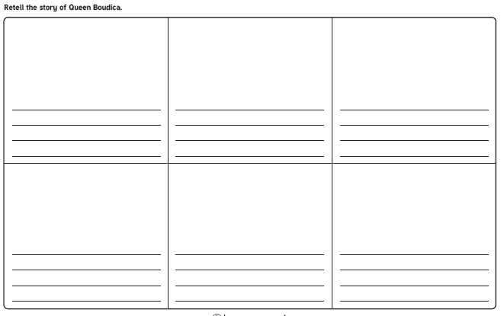

Slide 17
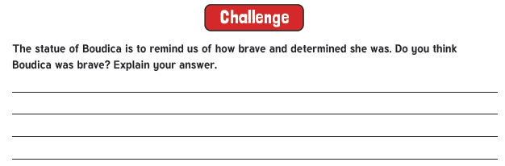

Slide 18
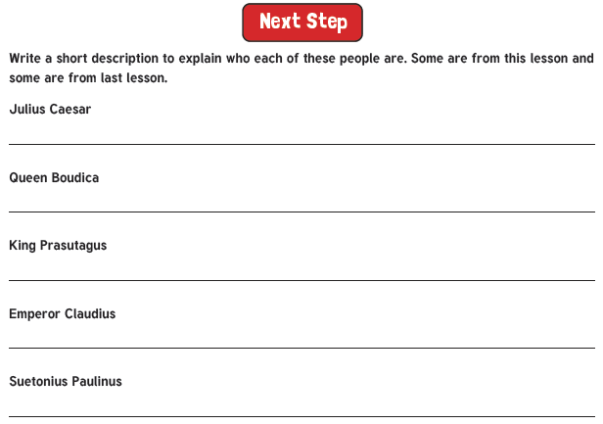

Slide 19
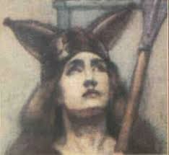

Boudica and her husband King Prasutagus ruled the Iceni tribe.
When the Romans invaded they were allowed to keep their lands.

Slide 20
As Boudica is Queen she can afford to buy expensive luxuries like oils, wines and perfumes that now come from distant lands, thanks to the Romans.

Slide 21
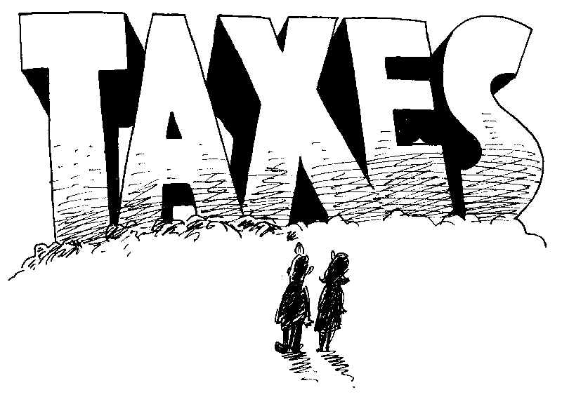
The Romans demand her land as taxes
but her father
is still loyal the Romans.

Slide 22
Boudica’s husband, King Prasutagus died,
leaving half of what he owns to the Roman emperor,
Nero, hoping that he will treat his family well.
Boudica got just the other half.

Slide 23
Boudica refuses to give up her land. The Romans tie her to a post and beat her and her daughters in front of people.

Slide 24
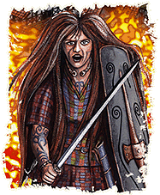
Boudica is determined to fight back.

Slide 25
Boudica raises an army and decides to teach the Romans a lesson by marching to Colchester.

Slide 26
Boudica and her army burn and destroy the town of Colchester.
She orders her tribe to kill every Roman.

Slide 27
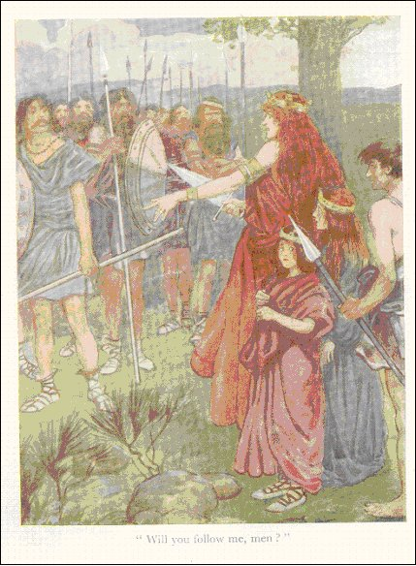
Boudica’s army grows in size.

Slide 28
The Roman governor and army are trapped by Boudica. They are outnumbered by ten to one.

Slide 29
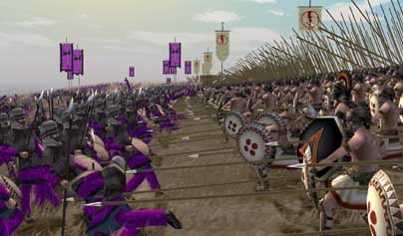
The battle begins, but Boudica and her army can not break through Roman lines.

Slide 30
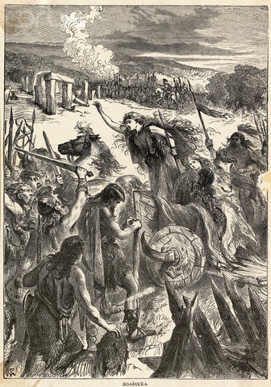
The Romans push forward and Boudica is forced to retreat. Many people die and Boudica and her army is defeated.

Slide 31
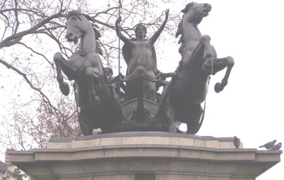
Fearing the worst for the future, Boudica
takes her own life using poison.

