Slide 1
Zechariah and Elizabeth

Slide 2
I hope and pray for my brother to get well.

Slide 3
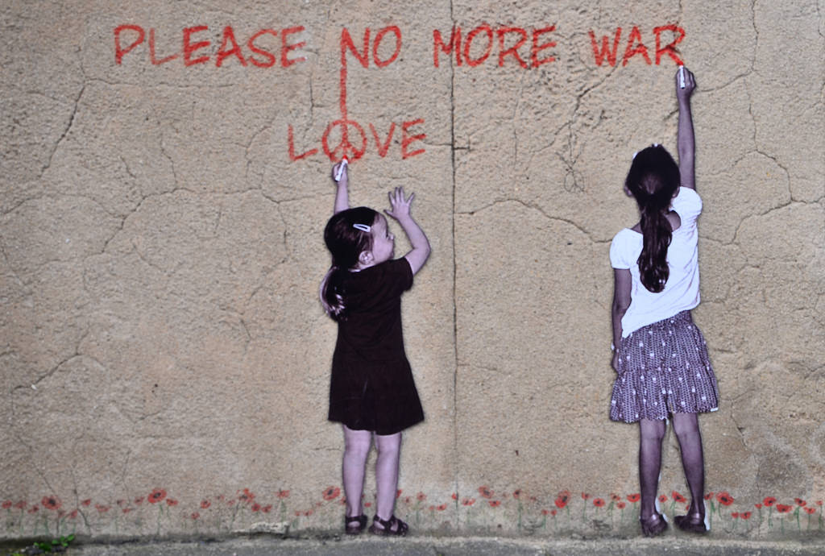
I hope and pray for peace in the world.

Slide 4
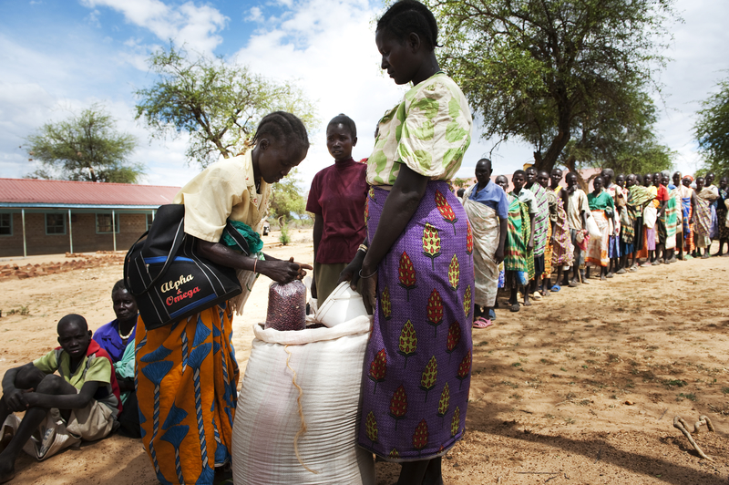
I hope and pray for enough food for my family.

