Slide 2
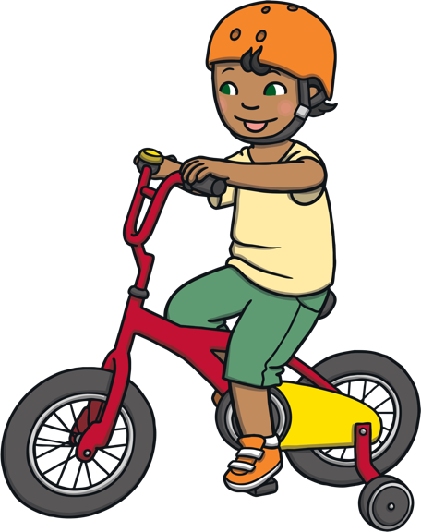
What are coordinating conjunctions?
Coordinating conjunctions are the words we use to link ideas together to make a compound sentence. They always connect phrases, words and clauses.
In the compound sentence below, two ideas have been combined into one sentence with the coordinating conjunction ‘so’.
I am going on a bike ride, so I will need to wear my new helmet.

Slide 3
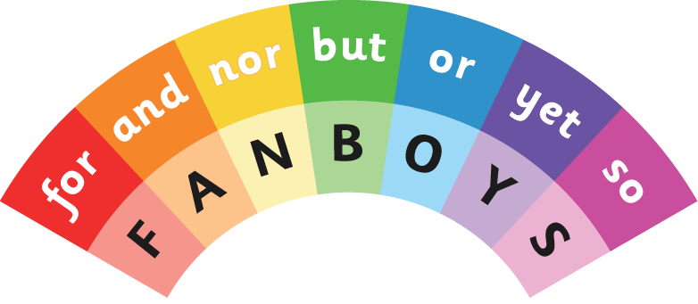
What is FANBOYS?
FANBOYS is an acronym used to help us remember the seven coordinating conjunctions used in the English language.
It stands for:

Slide 4
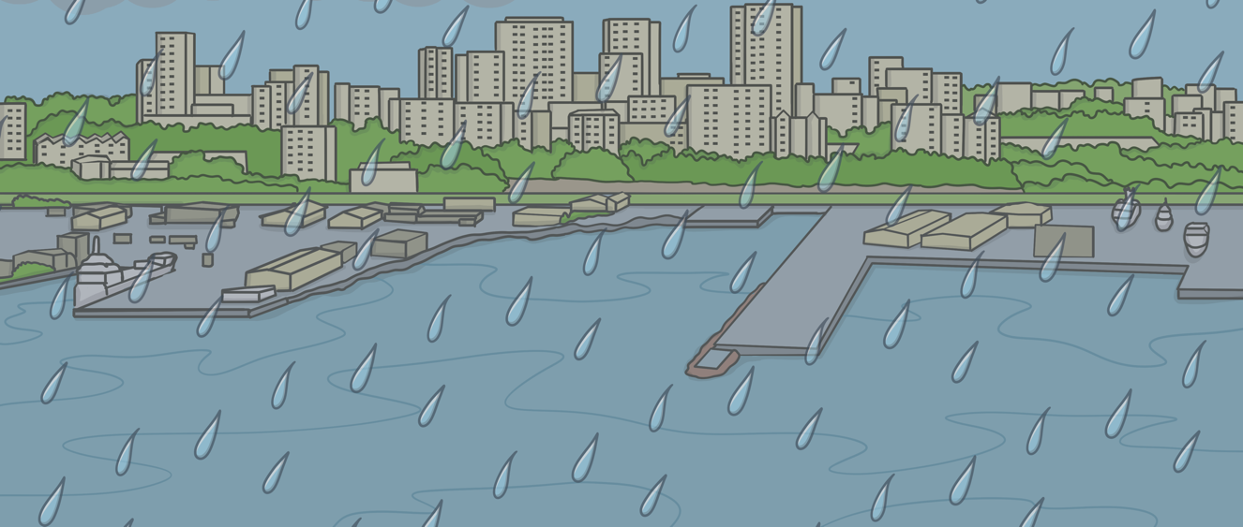
For
The word ‘for’ is used to explain a reason or purpose. It can be used in a similar way to ‘because’.
e.g. I think we will need to stay inside during lunch time today, for it is raining heavily outside.

Slide 5
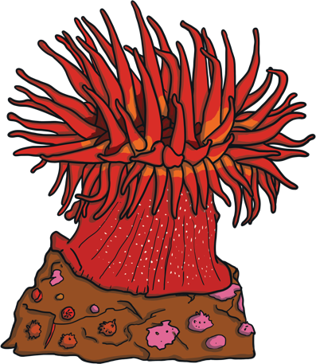
And
The word ‘and’ is used to show and link additional ideas into one sentence.
e.g. We are going on a holiday to visit my grandparents and to go snorkelling on the reef!

Slide 6
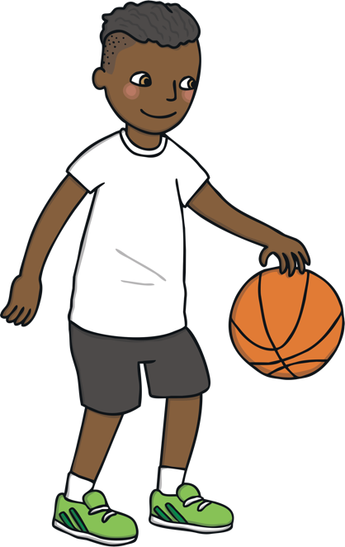
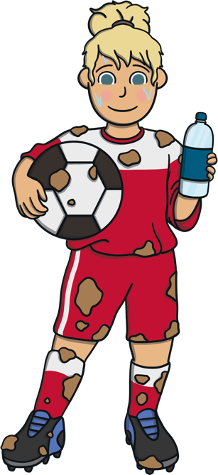
Nor
We can use ‘nor’ to offer an alternative negative idea to another negative idea.
e.g. I would rather not have to play basketball, nor do I want to play football.

Slide 7
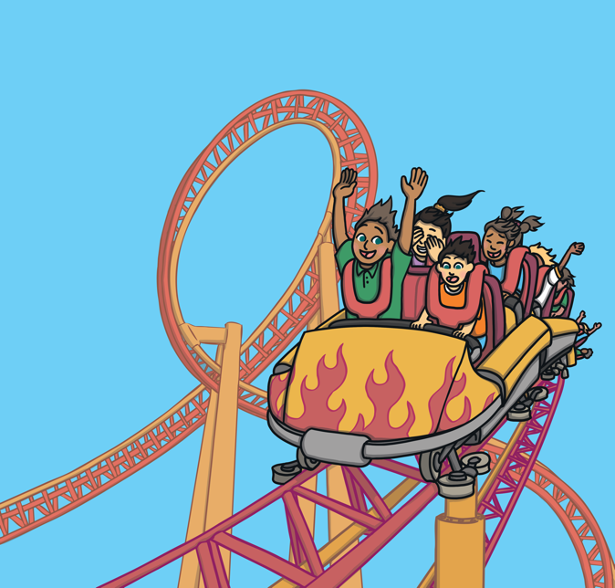
But
The conjunction ‘but’ is used to show contrast or to compare ideas.
e.g. The ferris wheel was pretty fun, but the roller coaster was my favourite!

Slide 8
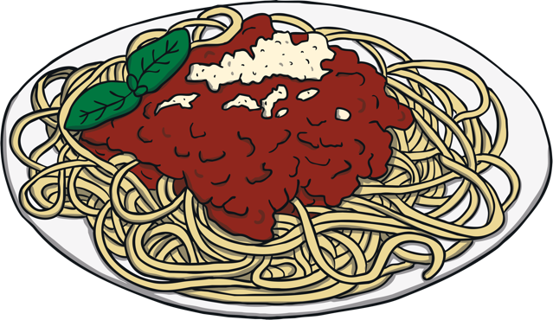
Or
We use the word ‘or’ to present a choice or alternative idea.
e.g. You can finish the leftover pasta for lunch, or you can make a toasted sandwich..

Slide 9
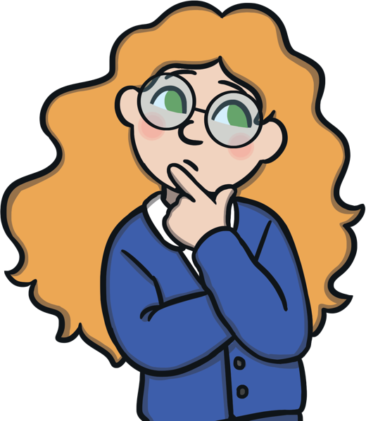
Yet
The word ‘yet’ is used to link a different or contrasting idea to the first idea in the sentence. It can be used in a similar way to ‘but’.
e.g. I always buy the large pack of bobby pins, yet I can never find one when I need it!

Slide 10
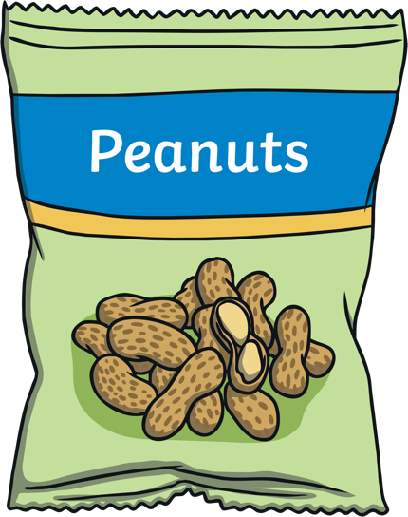
So
We use ‘so’ in compound sentences to help highlight a consequence or result.
e.g. I am allergic to peanuts, so I need to be very careful when I eat out.

Slide 11
Let’s practise!

